Slide 1


Bike rental forecasting

Slide 2


Slide 3

Team Members
PIYUSH SARAF – 19 BAI 10041 (piyush.saraf2019@vitbhopal.ac.in)
NAMIT RASTOGI – 19 BAI 10159 (namit.rastogi2019@vitbhopal.ac.in)
ANSHUMAN RAINA –19 BAI 10151 (anshuman.raina2019@vitbhopal.ac.in)
AADIL RAFIQ – 19 BAI 10169 (aadil.rafiq2019@vitbhopal.ac.in)
Guide
DR. SANDIP MAL

Slide 4
Acknowledgements
For this project, we are using the “Bike Sharing Demand” dataset. This dataset was provided by Hadi Fanaee Tork using data from Capital Bikeshare.
Capital Bikeshare.html
We also thank the UCI machine learning repository for hosting the dataset.
UCI ML respository.html

Slide 5

INTRODUTION
Name – Bike Rental Forecasting
Objective – Using historical usage patterns and weather data, forecast bike rental demand (number of bike users ) on hourly basis.
Tools – Various Machine Learning algorithms.
Outcomes – Reporting the model that performs the best, and fine-tune the same model using one of the model fine-tuning techniques, and report the best possible combination of hyperparameters for the selected model.
Lastly, use the selected model to make final predictions and compare the predicted values with the actual values.
https://yaana.net.in/

Slide 6
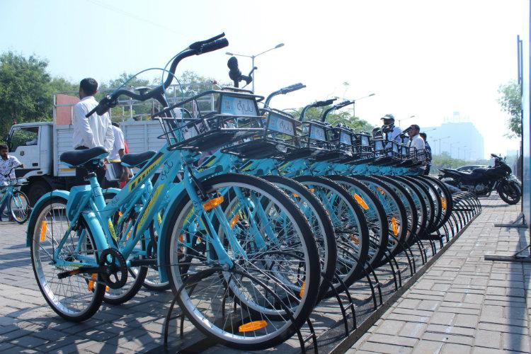
EXISTING WORK WITH LIMITATIONS
Currently, there are about over 500 bike-sharing programs around the world. In India, the concept of Yulu, Hexi, Yanna, Rapido, etc. are only confined in Metropolitan cities only. Also, the use of machine learning is nowhere to be seen. It has been observed by us that places with heavy traffic has shortage of bikes and in place of low traffic, bikes are being covered by dust!
We would apply machine learning for allocation of number of bikes in stands according to the traffic and usage. Also, we would find out number of users in different constraints such as weather, wind speed, humidity, weekdays or weekends, peak time, etc.

Slide 7

PROPOSED WORK AND METHODOLOGY
It was identified that we would approach the Students Union first about this Bike project as the backing of a strong, established organization within the VIT University which would greatly enhance our chances of receiving permission for the project.
By usage of our historical dataset and some current statistics from Bhopal and nearby places, we could feed all this data in our system to predict real time bike users on road and how much rent should be allocated for each bike.

Slide 8
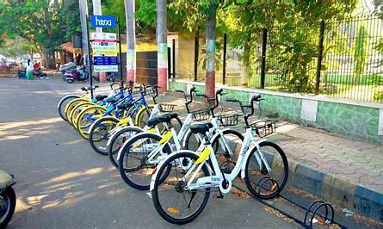
NOVELTY OF THE PROJECT
We wanted to undertake an interesting and worthwhile project.
Our idea would be huge asset to student life and poor people who couldn’t afford car rents.
Bike – a great financial viability with potential for expansion beyond the college into the local housing estates and area.
Also, this concept of Renting bicycles is a boon for transportation and towards an healthy environment.

Slide 9

REAL TIME USAGE
Our project will be for real-time systems and will be beneficial for companies who are giving bikes on rent for public usage.
The user of the bike will be provided all the details (such as distance travelled, time left, calories burnt, etc. )via an app and will get an alert message when the usage time gets over.
We will also add a support feedback for customers if they get stuck any where or have some issues regarding the bike.

Slide 10

HARDWARE AND SOFTWARE REQUIREMENTS
Hardware Requirements : - Workstation ( Laptop or PC), Fast-internet connection for real-time usage, a server to manage all the necessary databases and accounts.
Software Requirement – Python Compiler, and IDE such as Anaconda or Jupyter Notebook.

Slide 11
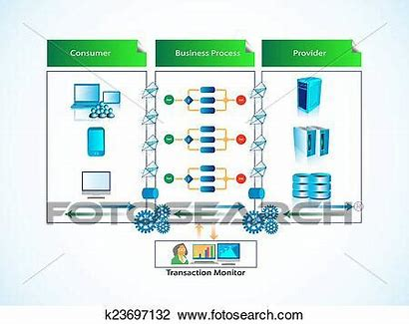
OVERALL SYSTEM ARCHITECTURE DIAGRAM
The steps for solving the problem will be as follows:
1) Importing the libraries.
2) Using some pre-defined utility functions.
3) Loading the data.
4) Cleaning the data.
5) Dividing the dataset into training & test dataset (using train_test_split in the ratio 70 : 30 ).
6) Training several models and analyzing their performance to select a model.
7) Fine-tuning the model by finding the best hyper- parameters and features.
8) Evaluating selected model using test dataset.

Slide 12
LITERATURE REVIEW
The number of cities offering bikeshare has increased rapidly, from just a handful in the late 1990s to over 800 currently. Several themes have begun to emerge from studies examining bikeshare. Convenience is the major motivator for bikeshare use. Financial savings has been found to motivate those on a low income and the distance one lives from a docking station is an important predictor for bikeshare membership.
Men use bikeshare more than women, but the imbalance is decreasing as cycles are getting modified and better. Users are less likely than private cyclists to wear helmets, but in countries with mandatory helmet legislation, usage levels have suffered. Bikeshare users appear less likely to be injured than private bike riders. Future directions include integration with e-bikes, GPS (global positioning system), dockless systems and improved public transport integration. Greater research is required to quantify the impacts of bikeshare, in terms of mode choice, emissions, congestion and health.
https://nacto.org/wp-content/uploads/2016/02/2016_Fishman_Bikeshare-A-Review-of-Recent-Literature.pdf

Slide 13

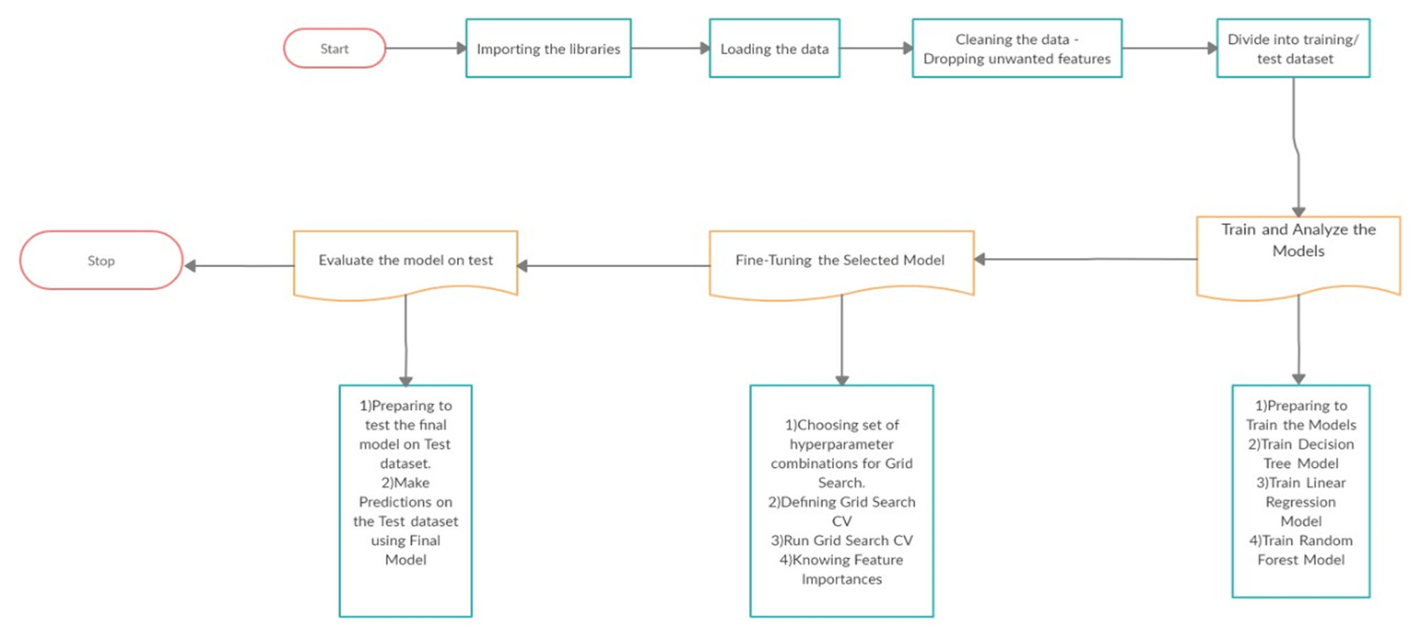
Module description and workflow

Slide 14
Implementation and coding
The flow of project will be as follows:
1) Importing the Libraries
2) Loading the Data
3) Cleaning the Data
4) Dividing into training/test dataset
5) Analyzing and Visualizing the dataset
6) Training and Analyze using different Machine Learning Algorithms
7) Fine Tuning the model
8) Evaluation and Testing

Slide 15
Importing the libraries
We will import these libraries into the environment
numpy: np
pandas: pd
sklearn - preprocessing, linear_model, StandardScaler, mean_squared_error
matplotplib.pyplot: plt
os

Slide 16
Loading the data
The dataset can be loaded from a csv which is present on the shared drive at the location: (Location: /cxldata/datasets/project/bikes.csv)
The dataset contains the following parameters:
instant: record index
dteday : date
season : season (1:springer, 2:summer, 3:fall, 4:winter)
yr : year (0: 20--, 1:20--) // the data were taken from the year 2011-2012
mnth : month ( 1 to 12)
hr : hour (0 to 23)
holiday : weather day is holiday or not (extracted from [Web Link])
weekday : day of the week
workingday : if day is neither weekend nor holiday is 1, otherwise is 0.
weekday : day of the week
workingday : if day is neither weekend nor holiday is 1, otherwise is 0.

Slide 17
Weather_conditions :
1: Clear, Few clouds, Partly cloudy, Partly cloudy
2: Mist + Cloudy, Mist + Broken clouds, Mist + Few clouds, Mist
3: Light Snow, Light Rain + Thunderstorm + Scattered clouds, Light Rain + Scattered clouds
4: Heavy Rain + Ice Pallets + Thunderstorm + Mist, Snow + Fog
temp : Normalized temperature in Celsius. The values are derived via (tt_min)/(t_maxt_min), t_min=*8, t_max=+39 (only in hourly scale)
atemp: Normalized feeling temperature in Celsius. The values are derived via (tt_min)/(t_maxt_min), t_min=*16, t_max=+50 (only in hourly scale)
hum: Normalized humidity. The values are divided to 100 (max)
windspeed: Normalized wind speed. The values are divided to 67 (max)
casual: count of casual users
registered: count of registered users
cnt: count of total rental bikes including both casual and registered

Slide 18
Cleaning the data
As we observed, some of the attributes are not required as per the requirement of the project: ['instant','casual','registered','atemp','dteday']. These can be dropped.
Some of the numerical columns will have to be scaled: ['temp','hum','windspeed’]
**( The cleaning is explained in the Code Comments properly)

Slide 19
Divide into training/test dataset
These features are derived from the raw set of features :
is Working: 1: Is a workingday and not a holiday,
0: Is not a workingday and Is a holiday
Month_Count: count of the number of months from the beginning of the dataset
xformHr: transform by shifting the hours by 5 hrs, if the hours are greater than 5, we subtract 5, else we add 19
dayCnt: count of the days from the beginning of the dataset
xformWorkHr: transforming the hour dataset to make non-working days to have hours from 25 to 48
cntDeTrended: De-trended count values

Slide 20
AnaLYZING AND VISUALIZING THE DATASET
These tasks shall be performed as a part of analyzing and visualizing the dataset:
Hourly count of bikes with trend and without trend
Correlation matrix between the features and the dependent variable
Plotting correlation among selected variables - 'yr','mnth','isWorking','xformWorkHr','dayCount','temp','hum','windspeed','cntDeTrended'
Plotting the count pattern with daycount for specific hours
Plotting box plot for different attributes: 'hr', 'mnth', 'weathersit', 'isWorking', 'dayWeek', 'xformHr'
Plotting scatter matrix for selected attributes: 'temp', 'hum', 'windspeed', 'hr', 'xformHr', 'cntDeTrended'
Plotting box plots for 0900 and 1800 hrs working and non-working days
Plotting the demand counts for each of the transformed work hours which include working and non-working hours

Slide 21
Training and analyze models
Models to be trained and analyzed:
DecisionTreeRegressor
LinearRegression
RandomForestRegressor
Metrics calculated: neg_mean_absolute_error, neg_mean_squared_error using cross-validation
Task 1: Complete the statement to define forest_reg as a RandomForestRegressor with random_state = 42
Task 2: Store predicted values from the classifier using cross_val_predict. As identified as action tasks Consider 'xformHr', 'xformWorkHr','temp' as the training features and 10 folds.
Features used:
xformWorkHr
temp
dayCount

Slide 22
Visualizing prediction versus actual values (Fine-tuning the model)
Task 1: Assign different combination of max_dept and min_samples_leaf and min_samples_split to param_grid - 'max_depth': [28, 30, 32, 34, 36], 'min_samples_leaf': [5, 10, 15, 12],'min_samples_split': [120, 128, 136]
Task 2: Calculate the best parameter using GridSearchCV and store it in grid_search. Print the parameters. from sklearn.model_selection import GridSearchCV
Task 3: Fit the training dataset to the calculated best parameter model using the fit() method.
Task 4: Complete the code to calculate the importance score for each of the feature.

Slide 23
Demo video It is uploaded separately !

Slide 24
testing
For Testing, we will execute the following steps:
1) Store the best estimator (that we got in Grid Search) into a variable final_model
2) Sort the values of test_set by 'dayCount' (axis=0 and inplace=True)
test_set.sort_values(<<your code comes here>>, axis=0, inplace=True)
3) Drop the cnt column(feature) from test_set dataframe (axis=1) and save the rest of the columns(features) into test_x_cols variable. test_x_cols now contains the list of columns(features) in the form of strings.
test_x_cols = (test_set.<<your code comes here>>, axis=1)).columns.values
4) Save the cnt string in test_y_cols variable. test_y_cols contains only one string i.e. cnt which is basically the target label that we need to predict.
5) Extract the values of test_x_cols columns(features) of test_set dataframe and store them in X_test dataframe variable.
X_test = test_set.loc[:,<<your code comes here>>]
6) Extract the value of test_y_cols column of test_set dataframe and store it in y_test variable.
y_test = test_set.loc[:,<<your code comes here>>]

Slide 25
RESULT
For the end result, we will use the final model to make predictions on the ‘Test’ data set and calculate the RMSE. Then compare the predicted values to the actual values.
We shall carry this out by executing the following steps:
1) Make the predictions using the final_model on X_test data set and store the output in a new column predictedCounts_test in the test_set dataframe.
test_set.loc[:,<<your code comes here>>] = final_model.<<your code comes here>>(X_test)
2) Calculate the mean squared error using mean_squared_error() function by passing to it the Test 'target' dataset (y_test) and the Test dataset predictions ('predictedCounts_test’ column data of test_set dataframe) to it, and store the output in 'mse' variable
mse = <<your code comes here>>(<<your code comes here>>, test_set.loc[:,'predictedCounts_test'])

Slide 26
3) Calculate the 'root mean square error' from the 'mse' and store it in final_mse variable.
4) Print final_mse
5) For a better understanding, you can have a look at the data inside test_set dataframe.
6) Please plot the predicted values v/s actual values using the below code:
times = [9,18]
for time in times:
fig = plt.figure(figsize=(8, 6))
fig.clf()
ax = fig.gca()
test_set_freg_time = test_set[test_set.hr == time]
test_set_freg_time.plot(kind = 'line', x = 'dayCount', y = 'cnt', ax = ax)
test_set_freg_time.plot(kind = 'line', x = 'dayCount', y = 'predictedCounts_test', ax = ax)
plt.show()

Slide 27
CONCLUSION
In this Project, we took a Bike Renting Dataset from CapitalShare Datasets and used Machine Learning to identify whether our model was able to perform on the unseen data or not. This dataset was for demonstration purpose. In real life, we would have been having a real-time dataset from any of the Bike Renting Companies and using that dataset, which we would have fed to our ML model, we would have optimized the Bike Renting facility.
We would like thank our Parents, our Guide, all the teachers for helping us to make this project a successful one. We hope so, that this project will help to eradicate a small but an important problem to the Common MAN!

Slide 28
Research papers used in this project
https://www.researchgate.net/publication/334401657_An_exploratory_study_of_the_bike_rental_system
https://arxiv.org/ftp/arxiv/papers/1709/1709.01493.pdf
Rani M., Vyas O.P. (2017) Smart Bike Sharing System to Make the City Even Smarter. In: Bhatia S., Mishra K., Tiwari S., Singh V. (eds) Advances in Computer and Computational Sciences. Advances in Intelligent Systems and Computing, vol 553. Springer, Singapore.
www.google.co.in
https://yaana.net.in/
https://nacto.org/wp-content/uploads/2016/02/2016_Fishman_Bikeshare-A-Review-of-Recent Literature.pdf
https://www.researchgate.net/publication/334401657_An_exploratory_study_of_the_bike_rental_system
https://arxiv.org/ftp/arxiv/papers/1709/1709.01493.pdf

Slide 29

THANK YOU!

